Slide 1

Technical Seminar Presentation (18EC8ICTHS)
Academic Year 2021-2022
Dayananda Sagar College of Engineering, Bangalore, Karnataka
Department of Electronics & Communication Engineering
SMART DUST USING MEMS
Presented by,
Name Sameer Gautam
USN 1DS18EC143
Section C
TS No.
TS Section Coordinator
Prof. Vibha T.G
Guide
Prof. Shobha A.S.

Slide 2
CONTENTS
Introduction
Literature survey
Problem Statement identified from the survey
Scope and Objective
Recommended solution
Methodolgy
Block Diagram
Results
Conclusion
References

Slide 3
INTRODUCTION
Merger of Computers, Mechanics and Electronics with miniaturization technology whose core is a small and low power computer/microcontroller which monitors the sensors embedded in the same chip.
Uses RF link for communicating and transmitting necessary information along with MEMS embedded in the same chip.
Components – Sensors, Battery, Reflectors and transmitters for reflecting the laser beams

Slide 4
LITERATURE SURVEY
Brett Warneke, Matt Last, Brian Leibowitz, Kristofer S.J Pister, “Smart Dust-Communicating with a cubic millimeter computer” IEEE Journal- Computer. January 2001. (Base Paper)
Dominic C. O‟Brien, Jing Jing Liu, Grahame E. Faulkner, Sashigaran Sivathasan, Wei Wen Yuan, Steve Collins, Steve J. Elston, “Design and Implementation of Optical Wireless Communications with Optically Powered Smart Dust Motes” IEEE JOURNAL ON SELECTED AREAS IN COMMUNICATIONS, VOL. 27, NO. 9, December 2009
Dr. M.H. Nerkar , Nand Kumar, ”Smart Dust” International Journal of Advanced Research in Computer and Communication Engineering, Vol. 5, Issue 6, June 2016
Nagamani Patil, Ramakrishna Pathak, Rashmi Meti, Sudeep Kashetti, “MEMS” International Journal of Scientific Research in Computer Science, Engineering and Information Technology, Volume 4, Issue 5, August 2018
Doug Steel, “Smart Dust”, UH ISRC TECHNOLOGY BRIEFING, March 2005.
Muhammad Mannir Ahmad Getso, Mohamed Ismail Z, “INTERNET OF THINGS AND SMARTDUST: THE FUTURE OF WIRELESS NETWORK SENSORS” International Journal of Information System and Engineering, Vol. 5 (No.1), April 2017

Slide 5
PROBLEM STATEMENT
The smart dust project envisions a complete sensor network node, including power supply, processor, sensors and communications mechanisms, in single cubic millimeters. The goal of the Smart Dust project is to build a millimeter scale sensing and communication platform for a massively distributed sensor network.
The development and use of smart dust raises some problems and concerns for stake holder including : Privacy issues, Potential system security weaknesses, and Environmental impacts of Smart Dust – Motes’ environmentally unfriendly components such as integrated circuit, battery, PCB and some motes draw on radioactive power sources.

Slide 6
SCOPE AND OBJECTIVE
According to UC Berkeley Professor Kris Pister who is a key founder, Smart Dust integrated with superior computing efficiency, wireless radios, and sensing tech, will be quite a comprehensive solution to study the real time data concerning people, industries, cities as well as natural environment.
The objective of this seminar is to demonstrate a family of distributed sensor network systems with Smart Dust using MEMS where each system consists of one or more data receivers and hundreds of thousands of sensor nodes to be used for a wide range of applications.

Slide 7
RECOMMENDED SOLUTION
Smart dust requires mainly revolutionary advances in miniaturization, integration & energy management.
Micro-Electro-Mechanical Systems (MEMS) is the integration of mechanical elements, sensors, actuators, and electronics on a common silicon substrate through microfabrication technology.
While the electronics are fabricated using integrated circuit (IC) process sequences, the micromechanical components are fabricated using compatible “micromachining” processes.
Microelectronic integrated circuits can be thought of as the "brains" of a system and allow Microsystems to sense and control the environment.
Historically, sensors and actuators are the most expensive and unreliable part of a sensor-actuator-electronics system. MEMS technology allows these complex electromechanical systems to be manufactured using batch fabrication techniques.
Smart Dust consists of the following integrated into a single package:
1. MEMS sensors 2. MEMS beam steering mirror for active optical transmission 3. MEMS corner cube retro reflector for passive optical transmission 4. An optical receiver 5. Signal processing and control circuitry 6. A power source based on thick film batteries and solar cells.

Slide 8
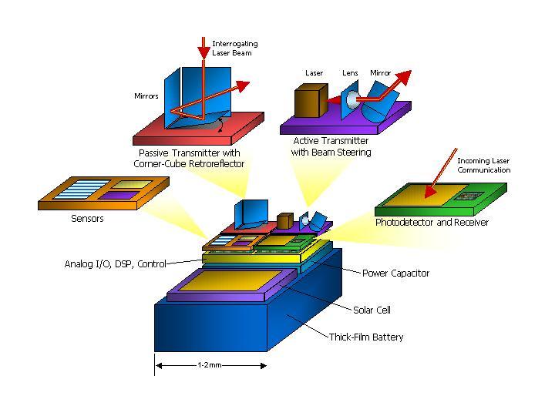
Smart dust employs 2 types of transmission schemes:
Passive transmission
Active transmission
The photo diode allows optical data reception.
Signal processing & control circuitry consists of analog I/O, DSPs to control & process the incoming data.
The power system consists of a thick film battery, a solar cell with a charge integrating capacitor for a period of darkness.
The Smart Dust mote is run by a microcontroller.
Periodically the microcontroller gets a reading from one of the sensors.
It also occasionally turns on the optical receiver to check for communication.

Slide 9
CONCLUSION
Smart dust is made up of thousands of sand-grain-sized sensors that can measure ambient light and temperature. Each of these sensors is called a "mote" which has wireless communications devices attached to them, and if you put a bunch of them near each other, they'll network themselves automatically.
Research in the wireless sensor network area is growing rapidly in both academic field and industry. Innovative research includes short-range micro power radio, energy scavenging from thermal gradients and vibration, operating systems, networking and signal processing algorithms, and applications.
While the raw power of future computing environments will enable more massive and amazing hardware and software networks, a growing community will be pushing the limits on the lower end, building smaller hardware and writing.

Slide 10
REFERENCES
http://robotics.eecs.berkeley.edu/~pister/SmartDust/
http://www.thestandard.com/article/0,1902,27573,00.html
http://www.wired.com/news/technology/0,1282,44101,00.html
http://www-bsac.eecs.berkeley.edu/~warneke/SmartDust/
http://www.ce.berkeley.edu/~glaser/Current%20Civil%20Applications.ppt
http://madmax.me.berkeley.edu/%7Eshadr/overview.html
https://www.classle.net/projects/node/406
http://www.wikid.eu/index.php/Smart_Dust/

